Slide 1

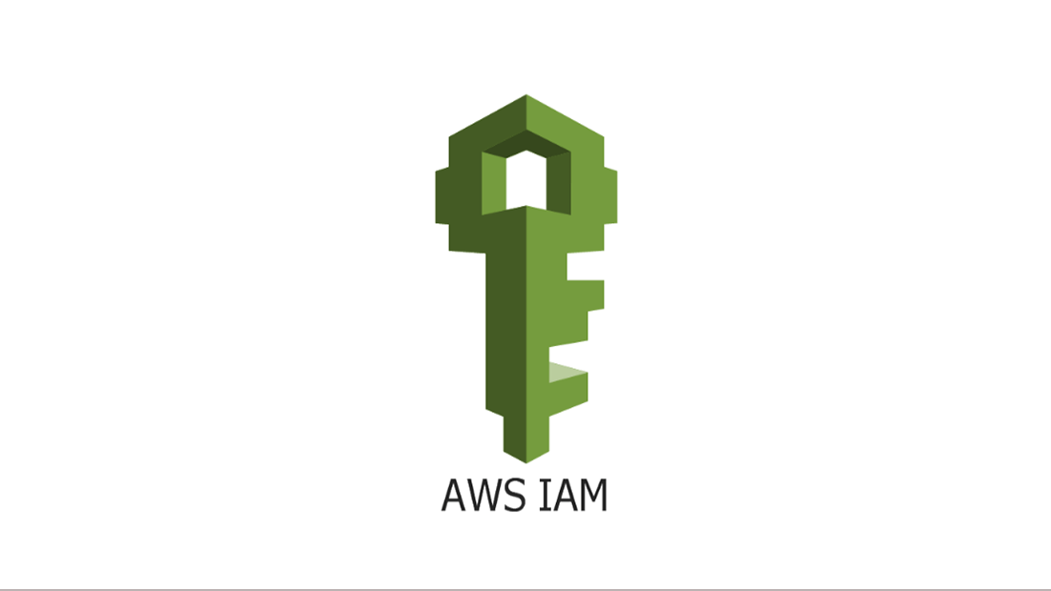
Section # 2
Introduction to AWS Terminologies
IAM

Slide 2
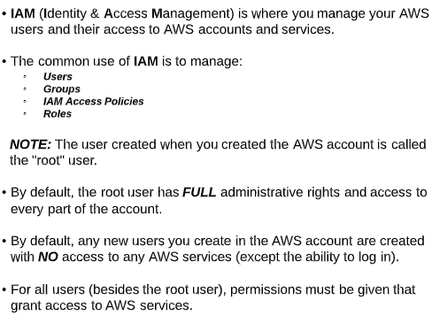
Introduction to IAM

Slide 3
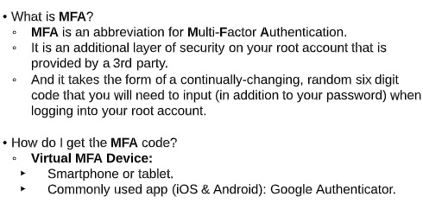
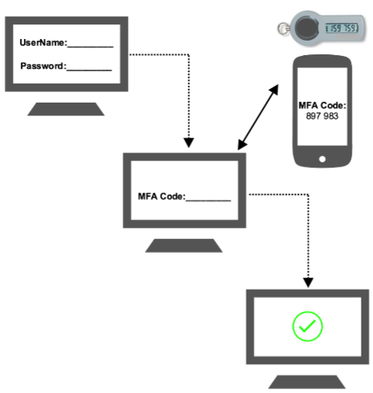
What is MFA

Slide 4
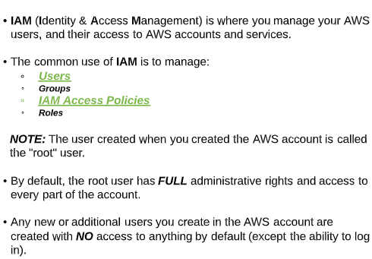
Users & Policies

Slide 5
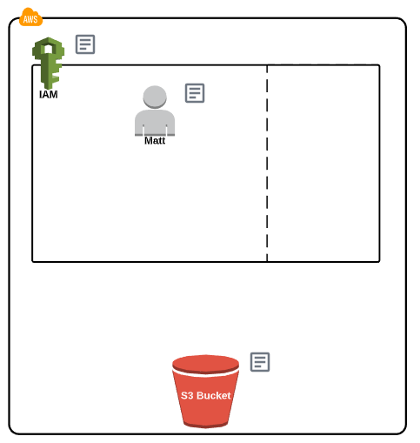
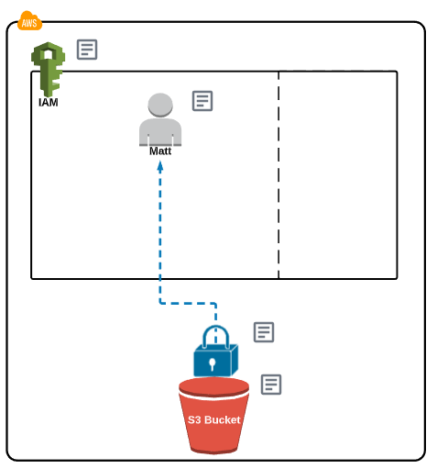
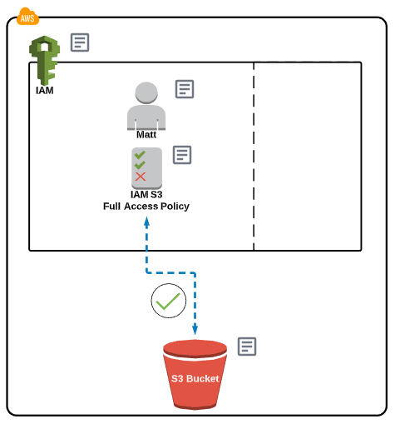
Users & Policies
1
2
3

Slide 6
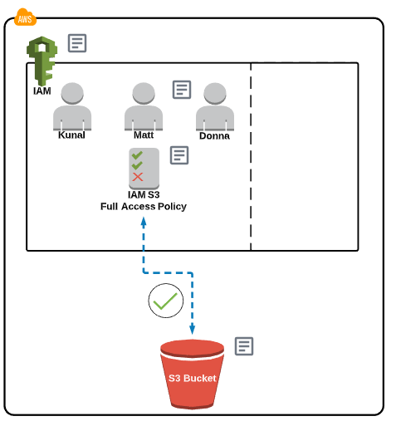
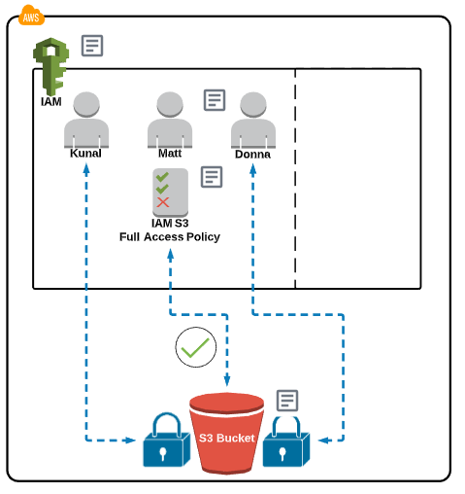
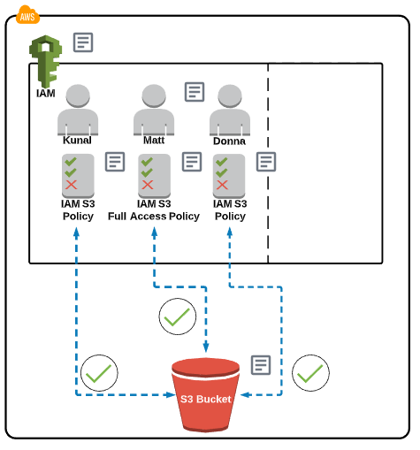
Users & Policies
1
2
3

Slide 7
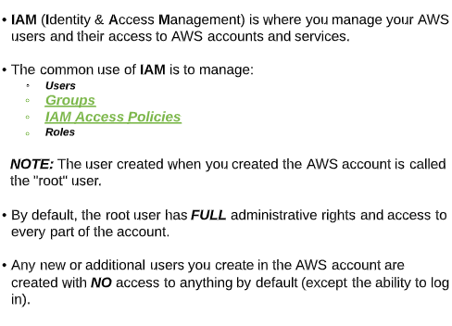
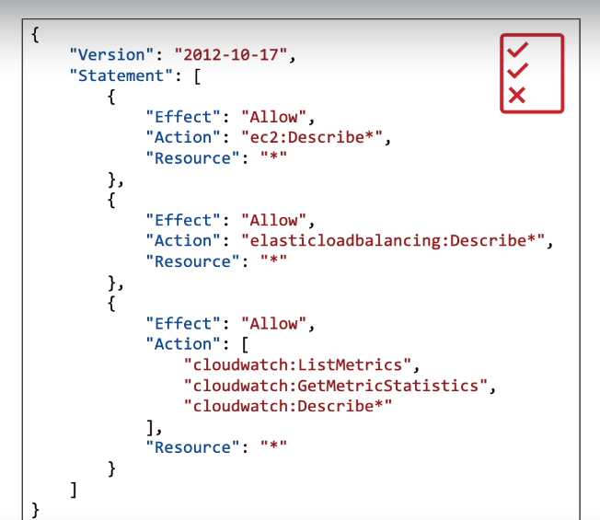
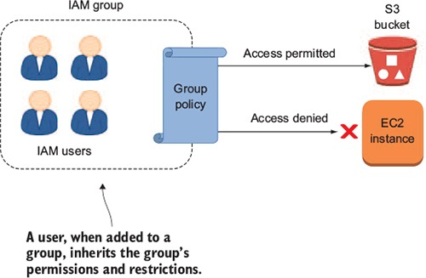
Group & Policies

Slide 8
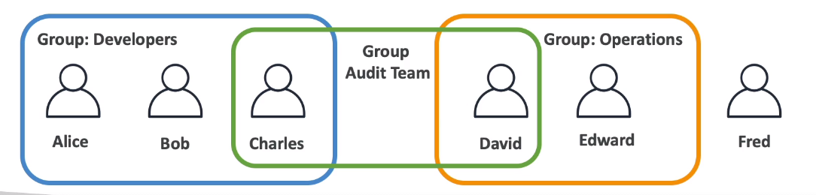
Group & Policies

Slide 9
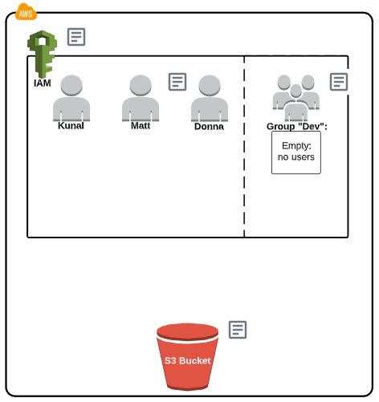
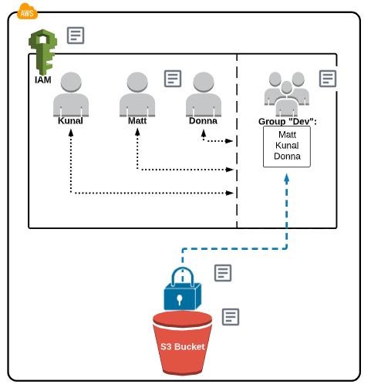
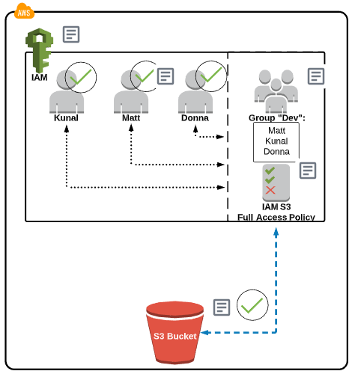
Group & Policies
1
2
3

Slide 10
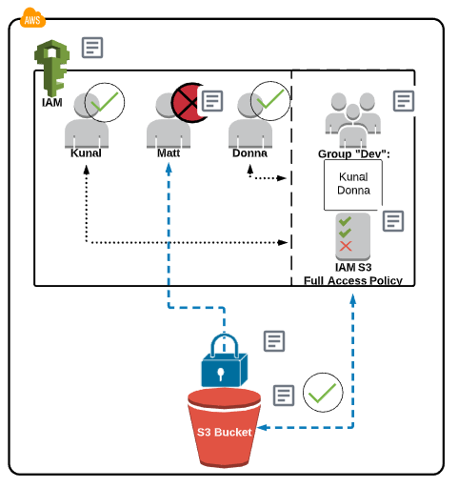
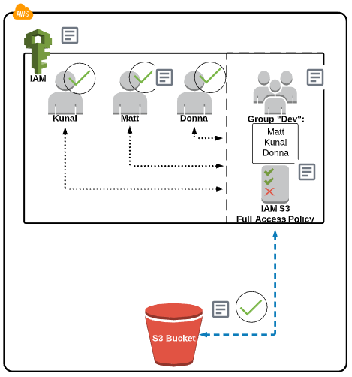
Group & Policies

Slide 11
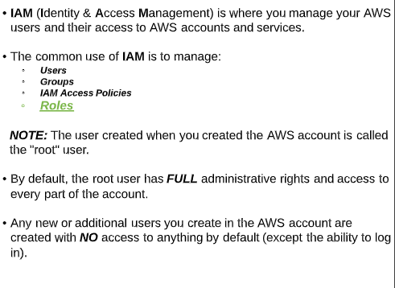
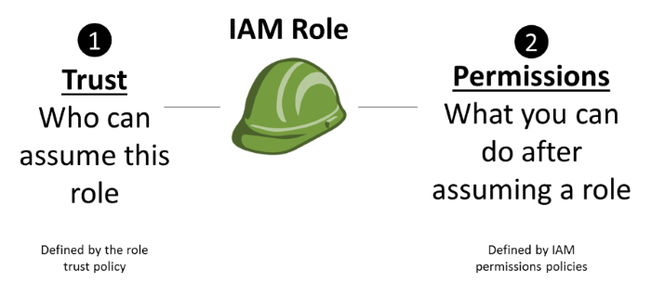
IAM Role

Slide 12
IAM Role
Trust policy – This policy defines the entities that can assume a role. When you create a role by using the IAM console, the trust policy is created for you. You can customize the trust policy after it has been created. A role can have only one trust policy.
Permissions policies – These policies define which AWS resources a role can access and the actions it can perform on those resources. These policies can be AWS managed policies, customer managed policies, or inline policies attached directly to the role. You can attach multiple permissions policies to an IAM role.

Slide 13
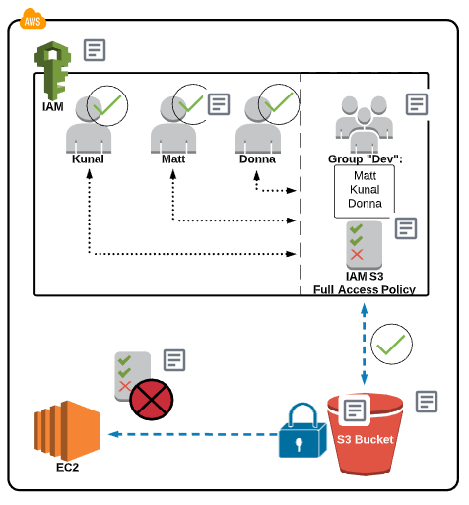
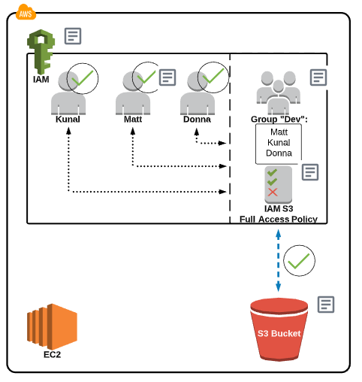
IAM Role
let's say that there is software running on an easy to server and that software needs to access information that is in an S3 bucket.
One AWS service trying to communicate and talk with another AWS service.
But AWS services you can't directly assign policies to other AWS services.

Slide 14
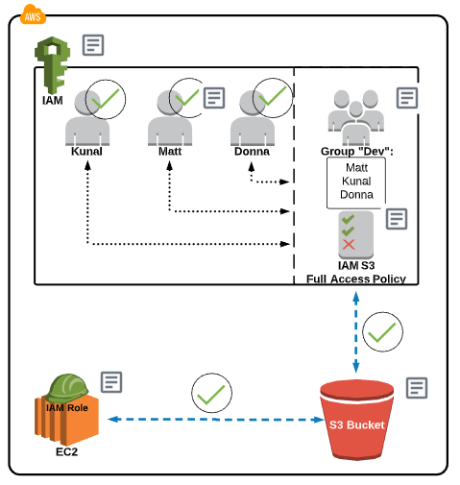
IAM Role
First you need to attach a role and then to the role you can attach policies.
What the role does in essence is give permissions to another AWS service to almost act as a user.
So we can assign a role to an EC2 instance that has the S-3 full access policy attached to it.
Thus granting the EC2 access to S3.

Slide 15
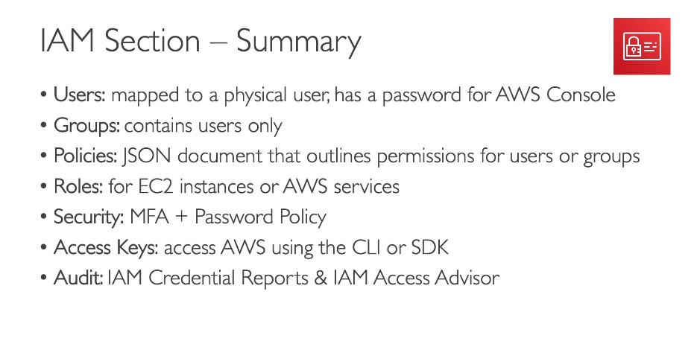

Slide 16
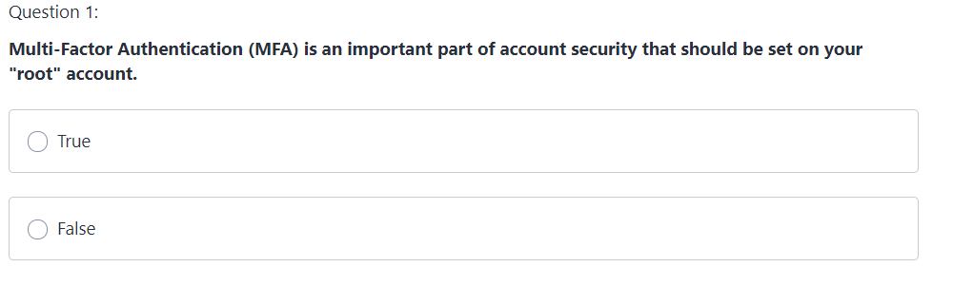
Quiz

Slide 17
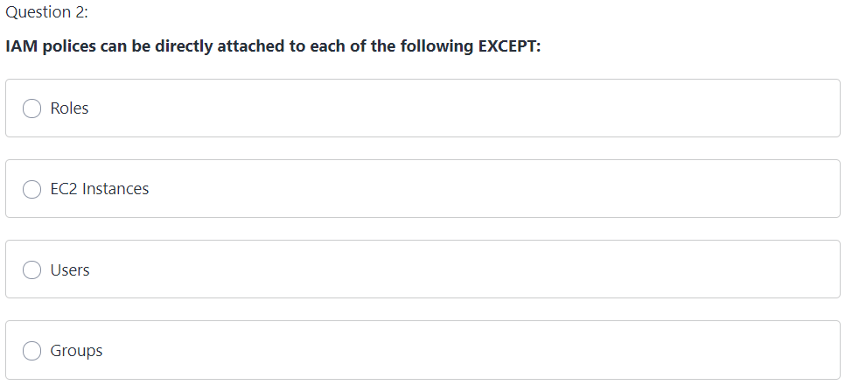
Quiz

Slide 18
Quiz

Slide 19
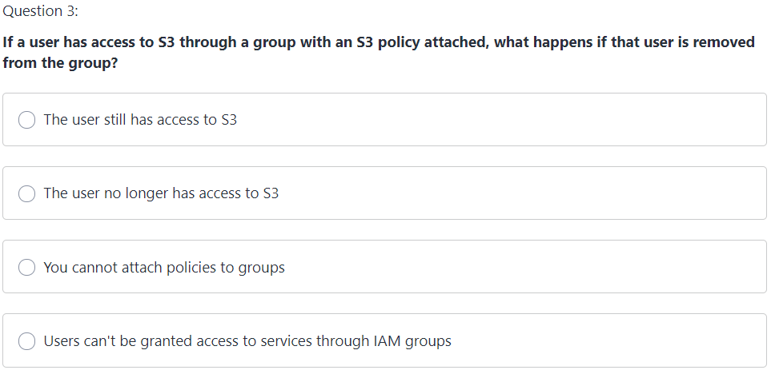
Quiz

Slide 20
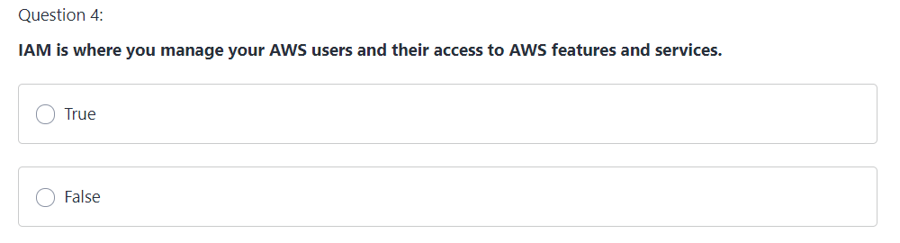
Quiz

Slide 21
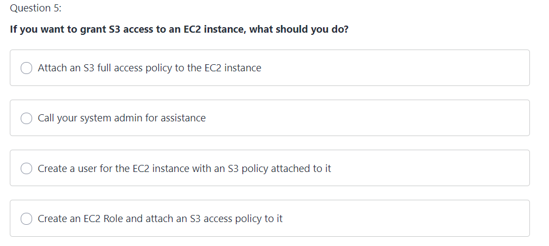
Quiz

Slide 22
Quiz

Slide 23
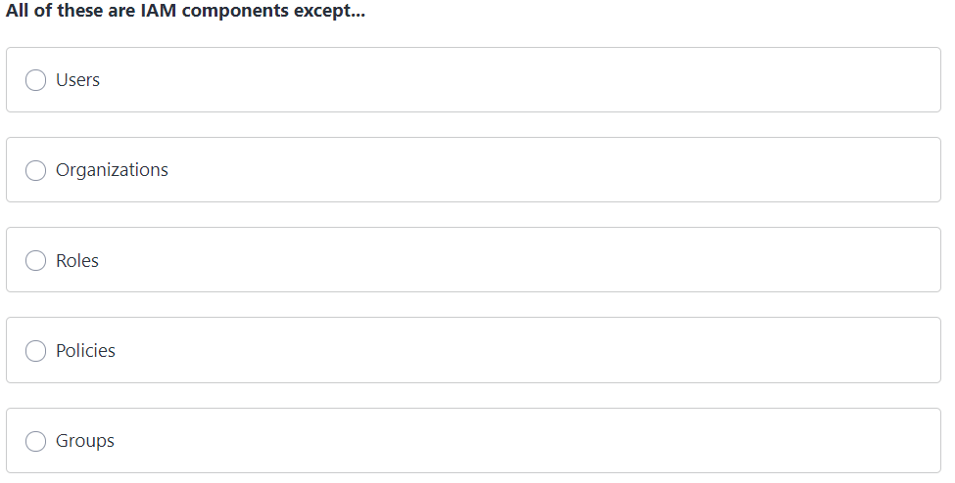
Quiz
Question 6:

Slide 24
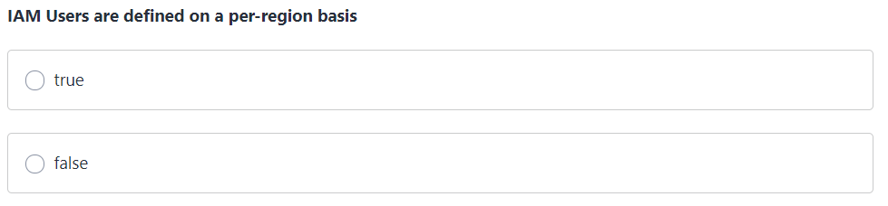
Quiz
Question 7:

Slide 25
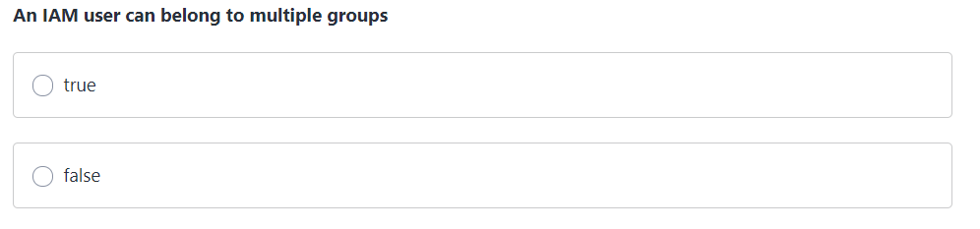
Quiz
Question 8:

Slide 26
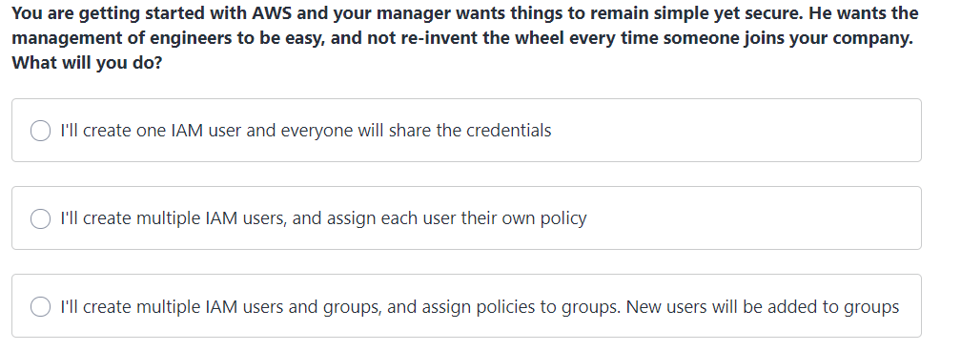
Quiz
Question 10:

Slide 27
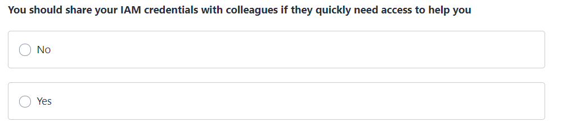
Quiz
Question 11:

Slide 28
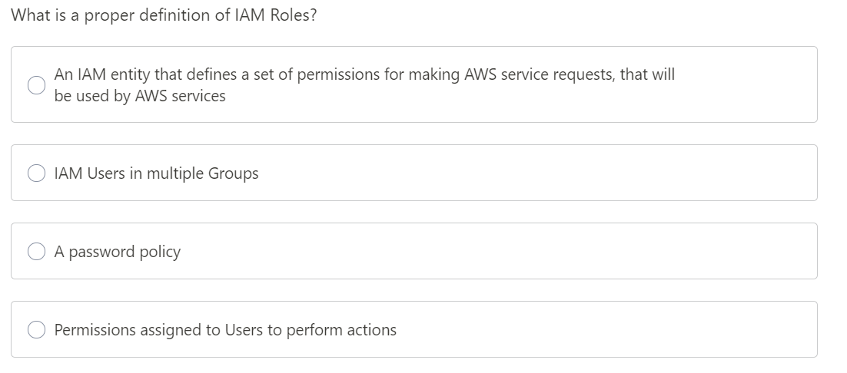
Quiz
Question 12:

Slide 29
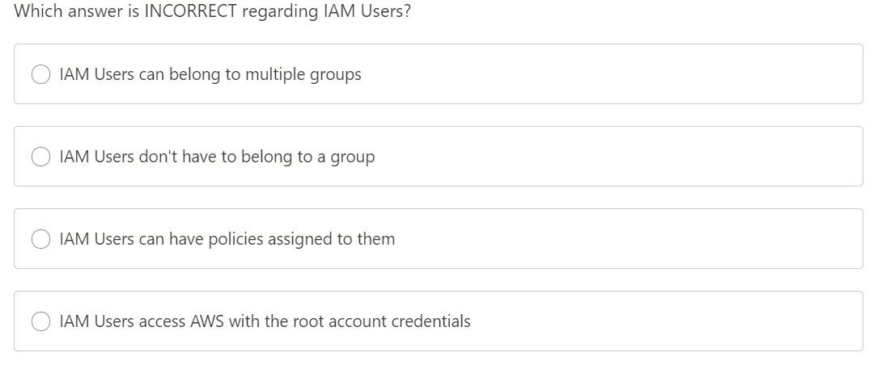
Quiz
Question 13:

Slide 30
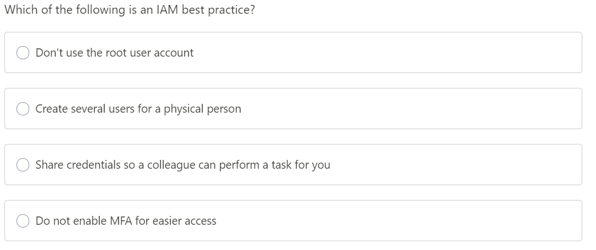
Quiz
Question 14:

Slide 31
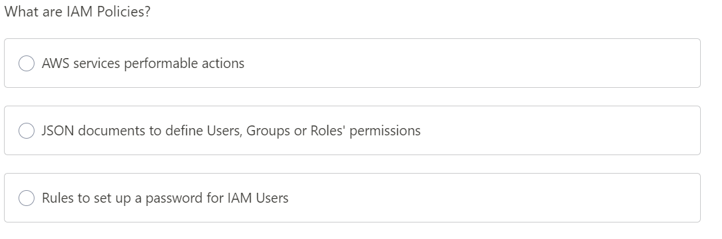
Quiz
Question 15:

Slide 32
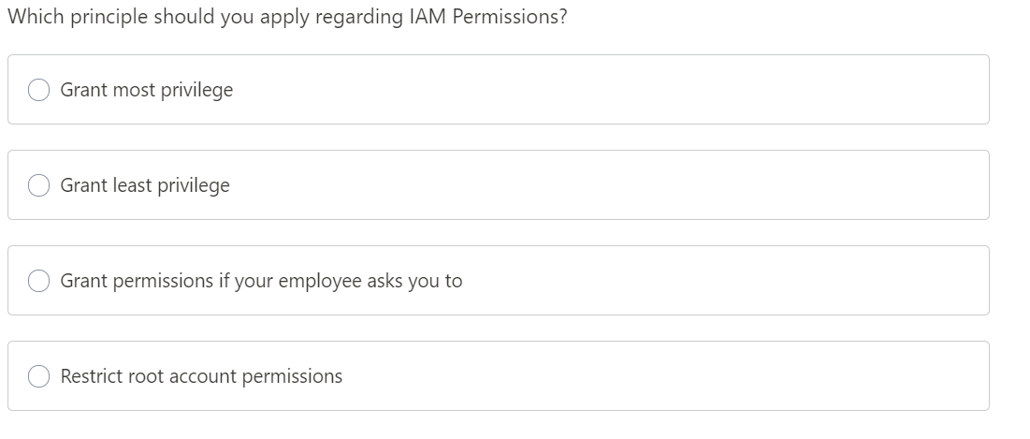
Quiz
Question 16:

Slide 33
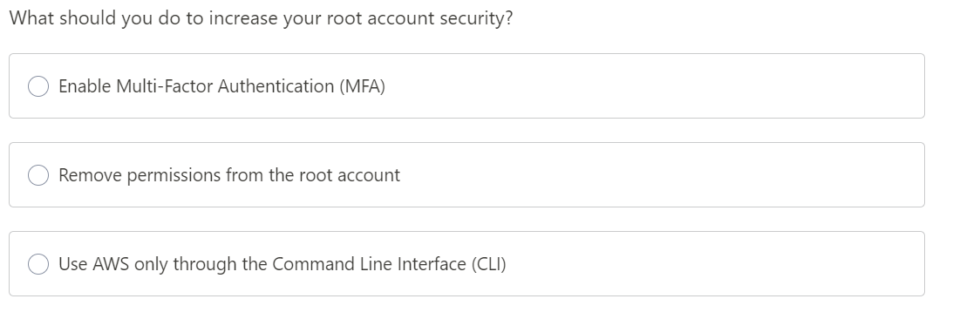
Quiz
Question 17:

Slide 34
Task
Create an IAM user and add him in a group & set Admin Access
Change alias
Log in through another browser
Remove the user from group and see the impact
Change the IAM policy to read only
Create an custom IAM policy and attach it to IAM user and see the impact

